Slide 1

Java Programming
Collection Framework
集合框架

Slide 2
Input students
public void inputStudents() {
int NumofStudent = 0;
int i = 0;
Scanner sc = new Scanner(System.in);
System.out.println("Number of students:");
NumofStudent = sc.nextInt();
students = new Student[NumofStudent]; //member variable
sc.nextLine();
while (i < NumofStudent) {
students[i] = inputAStudent(sc);
i++;
}
sc.close();
}

Slide 3
private Student inputAStudent( Scanner sc){
System.out.println("id:");
String id = sc.nextLine();
while (this.isExists(id)) {
System.out.println("the student already exists!");
System.out.println("id:");
id = sc.nextLine();
}
Student s = new Student(id);
System.out.println("name:");
String name = sc.nextLine();
System.out.println("weight(kg):");
double weight = sc.nextDouble();
System.out.println("height(m):");
double height = sc.nextDouble();
sc.nextLine();// because of the Scanner bug
s.setHeight(height);
s.setName(name);
s.setWeight(weight);
return s;
}

Slide 4
private boolean isExists(String id) {
for (int i=0; i < students.length; i++) {
if (students[i]==null) return false;
if (id.equals(students[i].getId()))
return false;
}
return true;
}
Notes:
在后面将介绍增强for语句语法

Slide 5
Problems
If we don’t know the number of students, how to store student objects?
How to sort the students by different attributes using Java API?
Notes:
http://www3.ntu.edu.sg/home/ehchua/programming/java/J5c_Collection.html

Slide 6
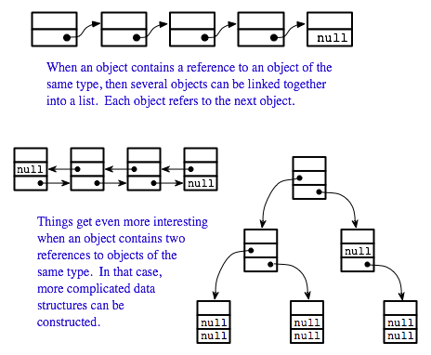
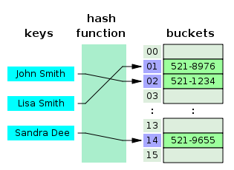
More than arrays
Although we can use an array to store a group of elements of the same type (either primitives or objects).
The array, however, does not support so-called dynamic allocation - it has a fixed length which cannot be changed once allocated.
Furthermore, array is a simple linear structure. Many applications may require more complex data structure such as linked list, stack, hash table, sets, or trees.

Slide 7
Outline
Collection frameworks(集合框架)
Generics(泛型)
Auto-boxing and auto-unboxing(自动装箱与拆箱)
Enhanced for-loop(加强型for循环)
Collection interfaces
List
ArrayList
Set*
Queue*
Map
HashMap

Slide 8
Collection framework(集合框架)
In Java, dynamically allocated data structures (such as ArrayList, LinkedList, Vector, Stack, HashSet, HashMap, Hashtable) are supported in a unified architecture called the Collection Framework, which mandates the common behaviors of all the classes.

Slide 9
Collection framework
A collection, as its name implied, is simply an object that holds a collection (or a group, a container) of objects. Each item in a collection is called an element.
A framework, by definition, is a set of interfaces that force you to adopt some design practices. A well-designed framework can improve your productivity and provide ease of maintenance.

Slide 10
Collection framework
The Java Collection Framework package (java.util) contains:
A set of interfaces,
Implementation classes, and
Algorithms (such as sorting and searching).
Similar Collection Framework is the C++ Standard Template Library (STL).

Slide 11
Collection framework
Since JDK1.5, the collection framework supports generic programming (which supports passing of types), and many related features (such as auto-boxing and unboxing, enhance for-loop).

Slide 12
Generics(泛型)
The idea—that the same code can be used for a variety of data types—is called generic programming(泛型编程). Such software entities are known as generics.
Generics allow us to pass type parameter, in the form of <type>, to the complier.
Notes:
See this link for more information http://docs.oracle.com/javase/tutorial/java/generics/types.html

Slide 13
Advantages of Generics
reduce duplication and improve productivity by implementing generic algorithms.
the compiler can perform all the necessary type-check during compilation to ensure type-safety at runtime.
Elimination of casts.

Slide 14
Generics
//prior to JDK1.5
List lst = new ArrayList();
//up cast String to Object
lst.add("alpha");
lst.add("beta");
lst.add("charlie");
Iterator iter = lst.iterator();
while (iter.hasNext()) {
//downcast manually
String str = (String)iter.next();
System.out.println(str);
}
//since JDK1.5
List<String> lst = new ArrayList<String>();
lst.add("alpha");
lst.add("beta");
lst.add("charlie");
Iterator<String> iter = lst.iterator();
while (iter.hasNext()) {
//downcast automatically
String str = iter.next();
System.out.println(str);
}
Notes:
思考怎么改成增强for循环

Slide 15
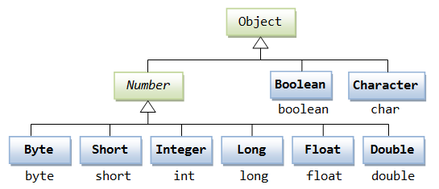
Auto-boxing and unboxing
A collection contains only objects. It cannot holds primitives (such as int and double).
Although arrays can be used to hold primitives, they are not resizable.
To put a primitive into a collection (such as ArrayList), you have to wrap the primitive into an object using the corresponding wrapper class.

Slide 16
Auto-boxing and unboxing
Boxing(装箱) is to wrap a primitive value into an object
Unboxing(拆箱) is to unwrap the primitive value from the wrapper object.
// Pre-JDK 1.5
Integer intObj = new Integer(5566); // wrap int to Integer
int i = intObj.intValue(); // unwrap Integer to int
Double doubleObj = new Double(55.66); // wrap double to Double
double d = doubleObj.doubleValue(); // unwrap Double to double

Slide 17
Auto-boxing and unboxing
Auto-boxing and auto-unboxing are used to simplify the wrapping and unwrapping processes.
// JDK 1.5
Integer intObj = 5566; // autobox from int to Integer
int i = intObj; // auto-unbox from Integer to int
Double doubleObj = 55.66; // autoboxing from double to Double
double d = doubleObj; // atuo-unbox from Double to double

Slide 18
Enhanced for-loop(加强型for循环)
JDK 1.5 also introduces a new enhanced for-loop, which you can use to transverse thru all the elements of a collection (as well as an array).
The syntax is as follows :
for ( type item : aCollection ) {
body ;
}
The loop variable item will take on each of the element of the collection, in each iteration of the loop-body.

Slide 19
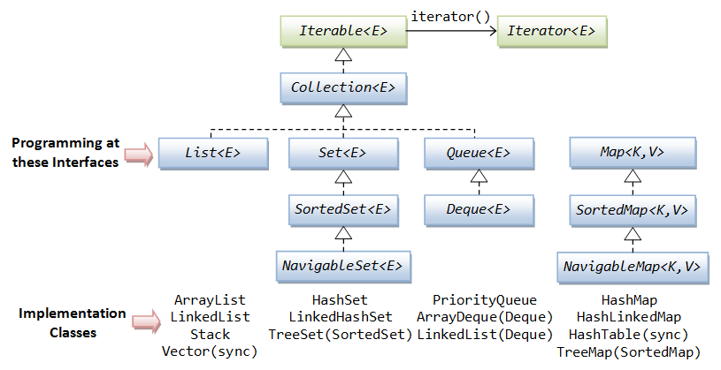
The Collection Interfaces(集合接口)

Slide 20
Extending an interface(接口继承)
interface Monster {
void menace();
}
interface DangerousMonster extends Monster {
void destroy();
}
interface Lethal {
void kill();
}
Notes:
Just as classes extend other classes, interfaces can extend other interfaces

Slide 21
interface Vampire extends DangerousMonster, Lethal {
void drinkBlood();
}
class VeryBadVampire implements Vampire {
public void menace() {
}
public void destroy() {
}
public void kill() {
}
public void drinkBlood() {
}
}

Slide 22
Collection<E> interface
The Collection<E> interface defines the common behaviors expected from a collection such as how to add and remove an element.
// Basic Operations
int size()
void clear()
boolean isEmpty()
boolean add(E element)
boolean remove(Object element)
boolean contains(Object element)

Slide 23
Collection<E> interface
// Bulk Operations with another Collection
boolean containsAll(Collection<?> c)
boolean addAll(Collection<? extends E> c)
boolean removeAll(Collection<?> c)
boolean retainAll(Collection<?> c)
//examples
x.addAll(y); //x=x ∪ y
x.removeAll(y); //x=x – y
x.retainAll(y); //x=x ∩ y
x.containsAll(y); // y ⊆ x

Slide 24
Collection<E> interface
// Comparison, Objects that are equal shall have the same hashCode
boolean equals(Object o)
int hashCode()
// Array Operations
Object[] toArray() // Convert to an Object array
<T> T[] toArray(T[] a) // Convert to an array of the given type T

Slide 25
Sub-interfaces of Collection<E>
List<E>: models a resizable linear array, which allows indexed access. List can contain duplicate elements.
Set<E>: models a mathematical set, where no duplicate elements are allowed.
Queue<E>: models queues such as First-in-First-out (FIFO) queue and priority queue. It’s sub-interface Deque<E> models queues that can be operated on both ends.

Slide 26
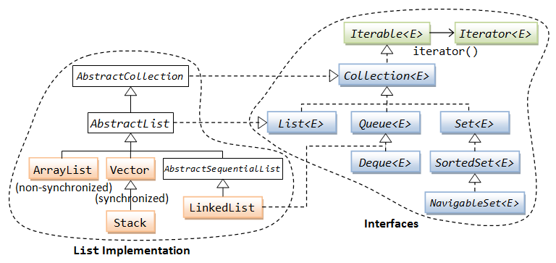
List<E>
A List is an ordered Collection (sometimes called a sequence). Lists may contain duplicate elements. Elements can be inserted or accessed by their position in the list, using a zero-based index.
Frequently-used implementations of List include ArrayList, Vector, LinkedListand Stack.

Slide 27
List<E>
Operations inherited from Collection<E>
int size()
boolean isEmpty()
boolean add(E element)
boolean remove(Object obj)
boolean contains(Object obj)
void clear();
......

Slide 28
List<E>
Operations at a specified index position
void add(int index, E element) // add
E set(int index, E element) // replace
E get(int index) // retrieve without remove
E remove(int index) // remove last retrieved
int indexOf(Object obj)
int lastIndexOf(Object obj)
Operations on a range fromIndex (inclusive) toIndex (exclusive)
List<E> subList(int fromIndex, int toIndex)

Slide 29
ArrayList<E> & Vector<E>
The ArrayList<E> is a linear data structure, similar to the array, but resizable.
ArrayList<E> is the best all-around implementation of the List<E> interface.
Vector<E> also implements a dynamic array, similar to ArrayList, but synchronized*.
Note: Synchronization involves overheads. Hence, if synchronization is not an issue, you should use ArrayList instead of Vector for better performance.

Slide 30
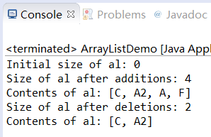
import java.util.*;
public class ArrayListDemo {
public static void main(String args[]) {
// create an array list
ArrayList<String> al = new ArrayList<String> ();
System.out.println("Initial size of al: " + al.size());
// add elements to the array list
al.add("C");
al.add("A");
al.add("F");
al.add(1, "A2");
System.out.println("Size of al after additions: " + al.size());
// display the array list
System.out.println("Contents of al: " + al);
// Remove elements from the array list
al.remove("F");
al.remove(2);
System.out.println("Size of al after deletions: " + al.size());
System.out.println("Contents of al: " + al);
}
}

Slide 31
Conversion between Array and List
Converting a List to an Array - toArray()
Using an Array as a List - Arrays.asList()

Slide 32
import java.util.List;
import java.util.ArrayList;
import java.util.Arrays;
public class TestToArray {
public static void main(String[] args) {
List<String> lst = new ArrayList<String>();
lst.add("alpha");
lst.add("beta");
lst.add("charlie");
// Use the Object[] version
Object[] strArray1 = lst.toArray();
System.out.println(Arrays.toString(strArray1)); // [alpha, beta, charlie]
// Use the generic type verion - Need to specify the type in the argument
String[] strArray2 = lst.toArray(new String[0]);
strArray2[0] = "delta"; // modify the returned array
System.out.println(Arrays.toString(strArray2)); // [delta, beta, charlie]
System.out.println(lst); // [alpha, beta, charlie] - no change in the original list
}
}
Notes:
<T> T[] toArray(T[] a)
Type Parameters:T - the runtime type of the array to contain the collection
Parameters:a - the array into which the elements of this list are to be stored, if it is big enough; otherwise, a new array of the same runtime type is allocated for this purpose.
Returns:an array containing the elements of this list

Slide 33
import java.util.List;
import java.util.ArrayList;
import java.util.Arrays;
public class TestArrayAsList {
public static void main(String[] args) {
String[] strs = {"alpha", "beta", "charlie"};
System.out.println(Arrays.toString(strs)); // [alpha, beta, charlie]
List<String> lst = Arrays.asList(strs);
System.out.println(lst); // [alpha, beta, charlie]
// Initialize a list using an array
List<Integer> lstInt = Arrays.asList(22, 44, 11, 33);
System.out.println(lstInt); // [22, 44, 11, 33]
}
}

Slide 34
Iterable<E> & Iterator<E>interface
The Iterable<E> interface declares one abstract method called iterator() to retrieve the Iterator<E> object associated with all the collections.
Iterator<E> iterator();
The Iterator(迭代器) object can then be used to traverse through(遍历) all the elements of the associated collection.
Notes:
Java Iterator和增强for循环区别
https://blog.csdn.net/shf4715/article/details/47029049
https://www.geeksforgeeks.org/iterator-vs-foreach-in-java/

Slide 35
Iterator<E> interface
The Iterator interface<E> declares the following abstract methods:
boolean hasNext() // returns true if it has more elements
E next() // returns the next element of generic type E
void remove() // removes the last element returned by the iterator

Slide 36
Traversal(遍历) using Iterator
List<String> lst = new ArrayList<String>();
lst.add("alpha");
lst.add("beta");
lst.add("charlie");
Iterator<String> iter = lst.iterator();
while (iter.hasNext()) {
String str = iter.next();
System.out.println(str);
}

Slide 37
Traversal using enhanced for
List<String> lst = new ArrayList<String>();
lst.add("alpha");
lst.add("beta");
lst.add("charlie");
for(String s : list) {
System.out.println(s);
}

Slide 38
Ordering, Sorting & Searching
The utility class java.util.Arrays and java.util.Collections provide many static method for the various algorithms such as sorting (using the Collections.sort() or Arrays.sort() methods) and searching.
here are two ways to specify the ordering of objects:
Make the objects implement the java.lang.Comparable interface, and override the compareTo() method to specify the ordering of comparing two objects.
Create a special java.util.Comparator object, with a method compare() to specify the ordering of comparing two objects.

Slide 39
java.lang.Comparable<T> Interface
It define one abstract method:
int compareTo(T o)
Returns a negative integer, zero, or a positive integer as this object is less than, equal to, or greater than the given object
It is strongly recommended that compareTo() be consistent with equals() and hashCode()
If compareTo() returns a zero, equals() should return true.
If equals() returns true, hashCode() shall produce the same int.

Slide 40
java.util.Comparator<T> Interface
This interface defines one abstract method:
int compare(T o1, T o2)
Returns a negative integer, zero, or a positive integer as the first argument is less than, equal to, or greater than the second.
You can pass a Comparator object into the sorting methods (Collections.sort() or Arrays.sort()) to provide precise control over the ordering.
The Comparator will override the Comparable, if available.

Slide 41
Input and sort the students
public class BMI {
private ArrayList<Student> students;
public static void main(String[] args) {
BMI bmi = new BMI();//initialize the students
bmi.sortStudents(bmi.new HeightComparator()); // NameComparator());
bmi.showStudents();
}
public BMI(){
students=new ArrayList<Student>();
inputUnknownStudents();
}
public void sortStudents(Comparator<Student> c) {
Collections.sort(students, c);
}
…
}

Slide 42
public void inputUnknownStudents() {
String choice;
Scanner sc = new Scanner(System.in);
while(true){
System.out.println("continue to input student?y/n");
choice = sc.nextLine();
System.out.println(choice);
if(choice.equals("y")){
Student s = inputAStudent(sc);
if(s!=null) students.add(s);
continue;
}else{ //finish the input
sc.close();
return;
}
}
}

Slide 43
private Student inputAStudent(Scanner sc){
System.out.println(“id:");
String id = sc.nextLine();
if (this.isExists(id)) {
System.out.println("the student already exists!");
return null;
}
Student s = new Student(id);
System.out.println(“name:");
String name = sc.nextLine();
System.out.println(“weight(kg):");
double weight = sc.nextDouble();
System.out.println(“height(m):");
double height = sc.nextDouble();
sc.nextLine(); // because of the Scanner bug
s.setHeight(height);
s.setName(name);
s.setWeight(weight);
return s;
}

Slide 44
private boolean isExists(String id) {
for (Student s : students) {
if (id.equals(s.getId()))
return true;
}
return false;
}

Slide 45
private class HeightComparator implements Comparator<Student> {
@Override
public int compare(Student st1, Student st2) {
if (st1.getHeight() > st2.getHeight()) {
return 1;
} else if (st1.getHeight() < st2.getHeight()) {
return -1;
}
return 0;
}
}

Slide 46
private class NameComparator implements Comparator<Student>{
@Override
public int compare(Student st1, Student st2) {
return st1.getName().compareTo(st2.getName());
}
}
How to reverse the sorting results?

Slide 47
Reverse the sorting results
public class BMI {
private ArrayList<Student> students;
public static void main(String[] args) {
BMI bmi = new BMI();//initialize the students
bmi.sortStudents(bmi.new HeightComparator().reversed()); // NameComparator());
bmi.showStudents();
}
public BMI(){
students=new ArrayList<Student>();
inputUnknownStudents();
}
public void sortStudents(Comparator<Student> c) {
Collections.sort(students, c);
}
…
}

Slide 48
Stack<E>
Stack<E> is a collection of elements, with two principal operations:
push, which adds an element to the collection, and
pop, which removes the most recently added element that was not yet removed.
The order in which elements come off a stack gives rise to its alternative name, LIFO (for last in, first out).

Slide 49
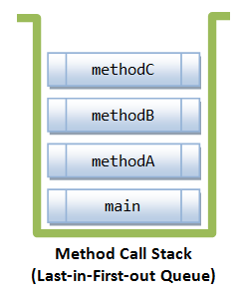
Stack<E>
import java.util.Stack;
public class TestStack {
public static void main(String[] args) {
Stack<String> st = new Stack<String>();
st.push("A");
st.push("B");
st.push("C");
System.out.println(st.pop());
System.out.println(st.pop());
System.out.println(st.pop());
}
}
C
B
A

Slide 50
Stack<E>
A typical application involves many levels of method calls, which is managed by a stack.
In the following example,
main() method invokes methodA();
methodA() calls methodB();
methodB() calls methodC().

Slide 51
public class MethodCallStackDemo {
public static void main(String[] args) {
System.out.println("Enter main()");
methodA();
System.out.println("Exit main()");
}
public static void methodA() {
System.out.println("Enter methodA()");
methodB();
System.out.println("Exit methodA()");
}
public static void methodB() {
System.out.println("Enter methodB()");
methodC();
System.out.println("Exit methodB()");
}
public static void methodC() {
System.out.println("Enter methodC()");
System.out.println("Exit methodC()");
}
}

Slide 52
Queue<E> & Deque<E>
A Queue<E> is a collection whose elements are added and removed in a specific order, typically in a first-in-first-out (FIFO) manner.
A Deque<E> (pronounced "deck" ) is a double-ended queue that elements can be inserted and removed at both ends (head and tail) of the queue.

Slide 53
LinkedList
LinkedList<E> is a double-linked list implementation of the List<E> interface, which is efficient for insertion and deletion of elements, in the expense of more complex structure.
LinkedList<E> also implements Queue<E> and Deque<E> interfaces, and can be processed from both ends of the queue. It can serve as FIFO or LIFO queue.

Slide 54
Set
A Set is a Collection that cannot contain duplicate elements.
There are three main implementations of Set interface:
HashSet, which stores its elements in a hash table, is the best-performing implementation; however it makes no guarantees concerning the order of iteration.
LinkedHashSet, which is implemented as a hash table with a linked list running through it, orders its elements based on the order in which they were inserted into the set (insertion-order).
TreeSet, which stores its elements in a red-black tree, orders its elements based on their values; it is substantially slower than HashSet.

Slide 55
Map
A map is a collection of key-value pairs. Each key maps to one and only value.
A map cannot contain duplicate keys.
Maps are similar to linear arrays, except that an array uses an integer key to index and access its elements; whereas a map uses any arbitrary key (such as Strings or any objects).

Slide 56
Map<K,V>
The interface declares the following abstract methods:
V get(Object key) // Returns the value of the specified key
V put(K key, V value) // Associate the specified value with the specified key
boolean containsKey(Object key) // Is this map has specified key?
boolean containsValue(Object value)
Set<K> keySet() // Returns a set view of the keys
Collection<V> values() // Returns a collection view of the values
Set entrySet() // Returns a set view of the key-value
…

Slide 57
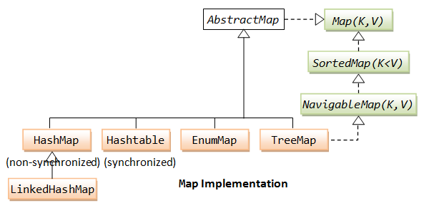
Map
There are three main implementations of Map interfaces: HashMap, TreeMap, and LinkedHashMap.

Slide 58
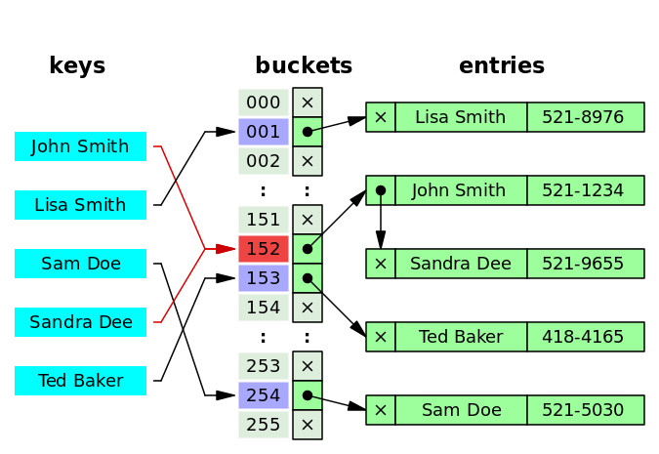
HashMap
A HashMap stores data into multiple singly linked lists of entries (also called buckets or bins).
All the keys with the same hash value are put in the same linked list (bucket).
https://en.wikipedia.org/wiki/Hash_table

Slide 59
hashCode() method
In Java, every class implicitly or explicitly provides a hashCode() method, which digests the data stored in an instance of the class into a single hash value (a 32-bit signed integer).
This property is important to the performance of hash tables and other data structures that store objects in groups based on their computed hash values.
All the classes inherit a basic hash scheme from the fundamental base class java.lang.Object, but instead many override this to provide a hash function that better handles their specific data.

Slide 60
import java.util.*;
public class WordCounterDemo {
public static void main(String args[]) {
HashMap<String, String> aMap = new HashMap<String, String>();
aMap.put("1", "Monday");
aMap.put("2", "Tuesday");
aMap.put("3", "Wednesday");
String str1 = aMap.get("1"); // No need downcast
System.out.println(str1);
Set<String> keys = aMap.keySet();
for (String str : keys) {
System.out.print(str);
System.out.print(":");
System.out.println(aMap.get(str));
}
}
}

Slide 61
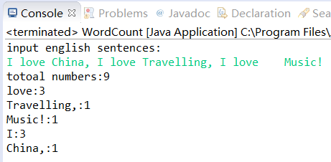
Counting Words
Input some English sentences, count and print the numbers of all the words and each different words.

Slide 62
public class WordCount {
public static void main(String[] args) {
System.out.println("input english sentences:");
Scanner in = new Scanner(System.in);
String sentances = in.nextLine();
HashMap<String,Integer> hm = new HashMap<String,Integer>();
StringTokenizer itr = new StringTokenizer(sentances);
System.out.println("totoal numbers:"+itr.countTokens());
while (itr.hasMoreTokens()) {
String word= itr.nextToken();
if (!hm.containsKey(word)){
hm.put(word, 1);
}else{
hm.put(word,hm.get(word).intValue()+1);
}
}
Set<String> keys = hm.keySet();
for (String str : keys) {
System.out.println(str+":"+hm.get(str));
}
}
}

Slide 63
Reading materials
http://www3.ntu.edu.sg/home/ehchua/programming/java/J5c_Collection.html
https://www.tutorialspoint.com/java/java_collections.htm

Slide 64


